Slide 1
Lesson 03 Vectors and Scalar Product
Interactive Seminar Slides
E114 – Mathematics for Engineering

Slide 2
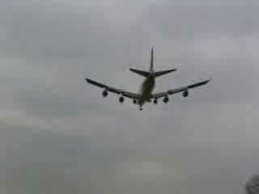
Scenario
Look at the following video on a typical landing of an aircraft:
How do you think the pilot manages to find out the direction to fly the aircraft so as to land it safely along the runway?
How would you represent the velocity of the aircraft within a single expression?

Slide 3

Scenario
In order to land safely on the runway, the recommended ground velocity
of the aircraft is km/h. Given that the current wind velocity
km/h,
Determine the air velocity of the aircraft such that the pilot can land the aircraft safely on the runway.
Determine the angle between the air velocity of the aircraft and wind velocity.
z
(Elevation)
y
Ground
(North)
x
$$O$$
(East)

Slide 4
Scenario Definition Template
What do we know?
What do we not know?
What do we need to find out?

Slide 5
Lesson Overview
S/N | Concepts | Slide Number
1 | Vectors and Scalars | 6
2 | Vector Representation | 7-11
4 | Vectors on x-y plane | 12
5 | Magnitude and direction of vector | 13-16
6 | Vectors Properties | 17-20
7 | Position vector and unit vector | 21-23
8 | 3 Dimensional vectors | 24-25
9 | Scalar product | 27-30
10 | Angle between 2 vectors | 31-36
11 | Scalar projection (CL) | 37-40

Slide 6
Vectors and Scalars
Vectors and Scalars are two basic types of quantities.
Scalars are quantities that only have magnitude (numerical value).
Speed, Mass, Distance
Vectors are quantities that have both magnitude and direction.
Velocity, Force, Displacement
Speed: 50 km/h
Speed: 50 km/h
Velocity: 50 km/h North
Velocity: 50 km/h East

Slide 7



Vector Representation
Algebraically, vectors can be labelled by a bolded lowercase letter, such as or uppercase letters of its start and end points, such as .
Vectors can be represented as follow:
Graphical representation:
Verbal description:
or is a vector of magnitude (length) 5 units that makes an angle of anti-clockwise from the positive horizontal axis
Column vector:
$$A$$
$$a$$
4
$$θ$$
$$O$$
3

Slide 8



Vector Representation
Vector representation can be converted from one form to another.
Recall from L02:
Graphical
$$A$$
$$a$$
5
4
Magnitude
& Direction
$$O$$
3
Column
Vector

Slide 9




Vector Representation - Column Vector
$$A$$
From graphical form, count the number of units along the x-axis and y-axis
Given magnitude $|a|$ and direction angle $θ$ measured from positive x-axis
$$|a|$$
y
$$O$$
x

Slide 10

Test Yourself (1)
Express the following graphical vectors as column vectors.

Slide 11
Think-Pair-Share
Given 2 vectors, BLUE and RED , as shown below, determine if the following statement is true or false. Discuss with your partner beside you.
“The BLUE vector is equal to the RED vector.”
10 units
10 units
y₁
y₂
150°
30°
30°
x₁
x₂
Magnitude = 10
Direction = 30˚ anticlockwise
from positive horizontal axis
Magnitude = 10
Direction = 150˚ anticlockwise
from positive horizontal axis

Slide 12
Vectors on the xy-Plane
For a column vector , there are the following 4 possibilities
On the xy-plane, we have
2nd quadrant
1st quadrant
y
y
−x
x
−y
−y
3rd quadrant
4th quadrant

Slide 13
Magnitude of a Vector
For a vector , its magnitude is given by
[Example]

Slide 14
Direction of a Vector
The direction of a vector is measured anti-clockwise from the positive horizontal axis.
Find the basic angle , where
Determine which quadrant the vector lies in.
Find the direction angle .
2nd quadrant
1st quadrant
3rd quadrant
4th quadrant

Slide 15
Magnitude and Direction of a Vector
[Example]
[Solution]
Find the magnitude and direction (measured anti-clockwise from positive horizontal axis) of the vector .
Magnitude
Direction
1. Basic angle,
2. Lies in 3rd quadrant
3.

Slide 16
Test Yourself (2)
Find the magnitude and direction (measured anti-clockwise from positive
horizontal axis) of the vector .

Slide 17
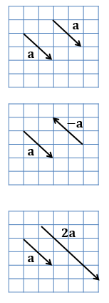
Vector Properties (I)
Equal Vectors
Two vectors having the same magnitude and direction, irrespective of their point of origins.
Negative Vectors
A vector having the same magnitude but opposite direction to a vector , is represented as .
Multiple of a vector
If vector is multiplied by a constant k, we obtain a parallel vector as that of with its magnitude being k times of . For example, the magnitude of is twice of .

Slide 18
Vector Operations (II)
Representing vectors in column vector form makes it convenient for us to perform calculation such as:
Vector Addition:
Vector Subtraction:
Scalar Multiplication:
The results are still vectors.

Slide 19
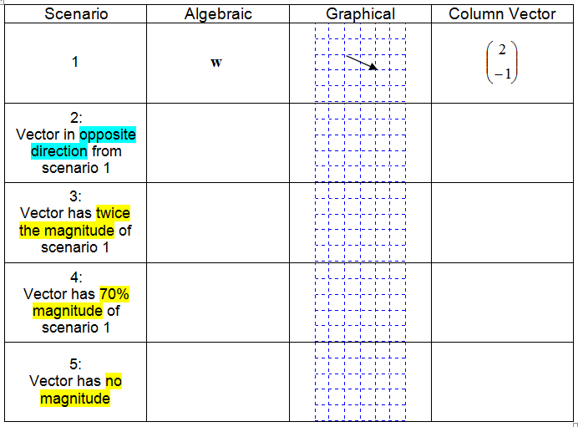
Test Yourself (3)

Slide 20
Test Yourself (4)
Given , find

Slide 21

Test Yourself (5)
A ferry is towed by two tugboats A and B. Force A is a horizontal force of 300 N while Force B of 550 N is inclined at an angle of 50° to the horizontal as shown in the diagram. Calculate the magnitude of the resultant force on the ferry and the direction the ferry will be pulled towards.
Tugboat B, 550 N
50˚
Tugboat A, 300 N
Ferry

Slide 22

Position Vectors
A position vector represents the position of a point A(x, y) in space in relation to an arbitrary reference origin O.
Express the vector in terms of and
A
B
$$O$$
[Example] Given the points A(3, 5) and B(2, 3), determine
[Solution]

Slide 23
Test Yourself (6)
Consider the points M = (−1, 4) and N = (3, 10). Find and determine if
it is parallel to .

Slide 24
Unit Vector
An Unit Vector is a vector with magnitude equals to 1 unit.
Divide any non-zero vector by its magnitude to obtain its unit vector.
Find the unit vector of .
Verification:
[Example]
[Solution]

Slide 25

3-Dimensional Space
Adding the z-axis to the xy-plane, the 3-D space is constructed as shown below.
A 3-D vector is written as:
Magnitude
Unit vector of
z
P (3, 2, 4)
y
4
To reach the point P (3, 2, 4):
+3 units along the x-axis,
+2 units in the y-direction,
+4 units in the z-direction.
2
$$O$$
x
3

Slide 26
Test Yourself (7)
Suppose an airplane is taking off from the origin O and flying towards the point P. It moves +2 units in the x-direction, +3 units in the y-direction and +5 units in the z-direction. Use a column vector to represent and find its magnitude and unit vector.

Slide 27
BRAIN BREAK
It’s not that I’m so smart,
it’s just that
I stay with problems longer
-- Albert Einstein

Slide 28

Scalar Product in 2-D
u
u
b
v
$$θ$$
d
v
α
β
a
c
Angle between and ,
Scalar product (or Dot product)
[Example]

Slide 29
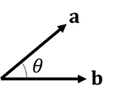

Scalar Product in 3-D
Consider the 3-D vectors and .
Let $θ$ be the angle between and .
[Example]
The answer for scalar product is a scalar!
Do not write this way:

Slide 30
Some Properties of Scalar Product
Commutative law:
Distributive law:
Scalar product and magnitude of a vector

Slide 31
Test Yourself (8) (Kahoot.it)
Consider the vectors and . Determine if the
following expression is true or false.

Slide 32

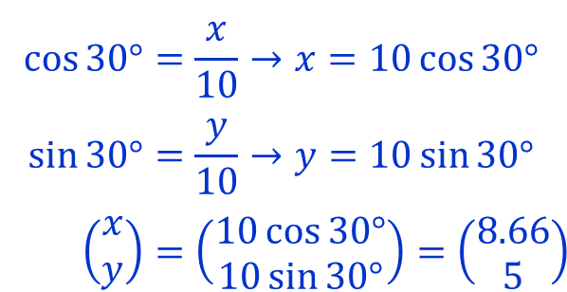


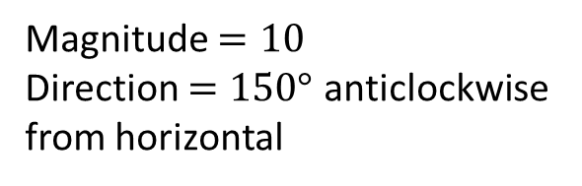

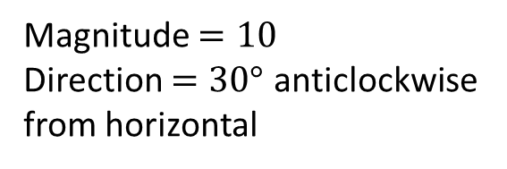






Angle Between Two Vectors
The angle $θ$ between two vectors $a$ and $b$ is the smaller angle made where the tails or heads of both vectors meet.
Hence, the angle 𝜃 between two vectors is always 0°≤ θ ≤180°.
$$b$$
$$a$$
$$θ$$
$$θ$$
$$a$$
$$b$$
Tail-Tail
Head-Head
$$b$$
$$a$$
$$a$$
$$θ$$
$$θ$$
$$b$$

Slide 33


Test Yourself (9)
Determine the angle between the following two vectors.
Vertical
$$a$$
70˚
130˚
$$b$$
Horizontal

Slide 34

Angle Between Two Vectors
Find the angle $θ$ between the vectors and .
[Example]
[Solution]

Slide 35

Test Yourself (10)
Determine the cosine of the angle between the two vectors:
and
Hence, find the angle $θ$ between the 2 vectors.

Slide 36
Test Yourself (11)
Find the angle between and .

Slide 37
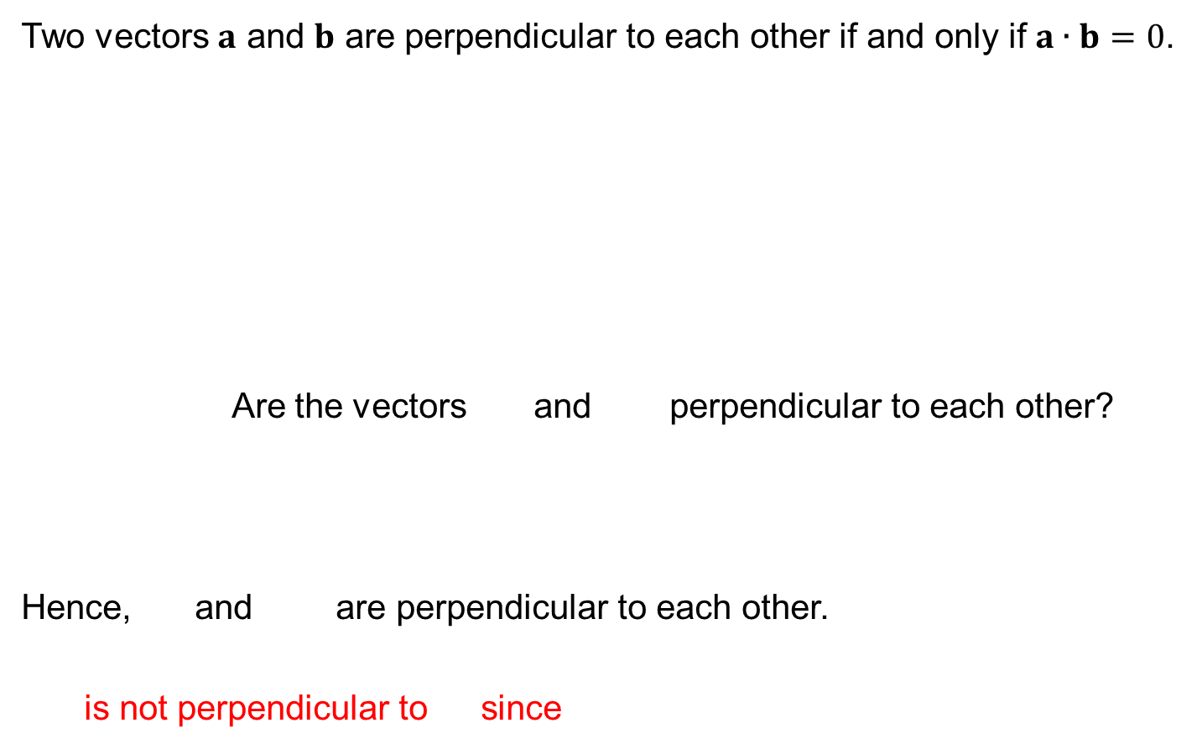

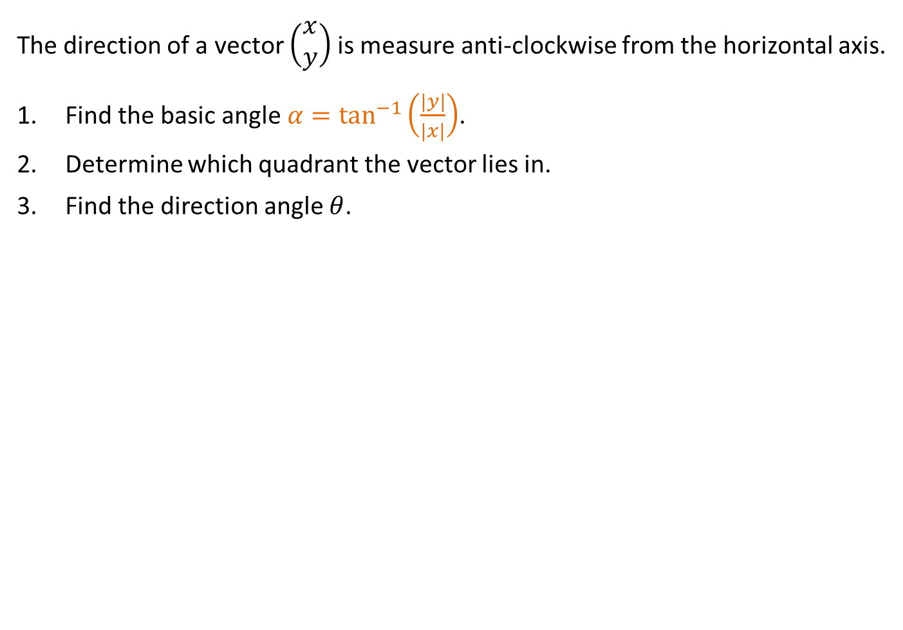

Perpendicular Vectors
Two vectors $a$ and $b$ are perpendicular to each other if and only if $a∙b=0$.
Are the vectors and perpendicular to each other?
Hence, and are perpendicular to each other.
is not perpendicular to since
$$a$$
$$θ$$
$$b$$
[Example]
[Solution]

Slide 38
Poll (Kahoot.it)
The vectors and are perpendicular to each other. Find the value of p.
a) 6
b) −6
c) −1
d) −5

Slide 39
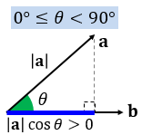
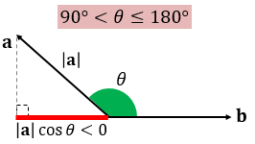
Scalar Projection (CL)
The scalar projection of a vector onto a vector is
“the length of the shadow of cast onto ”
(The scalar projection is negative if θ is ).
If θ is the angle between and , then the scalar projection of onto is
Hence the scalar projection of a vector onto a vector is given by the scalar product of and the unit vector of .

Slide 40
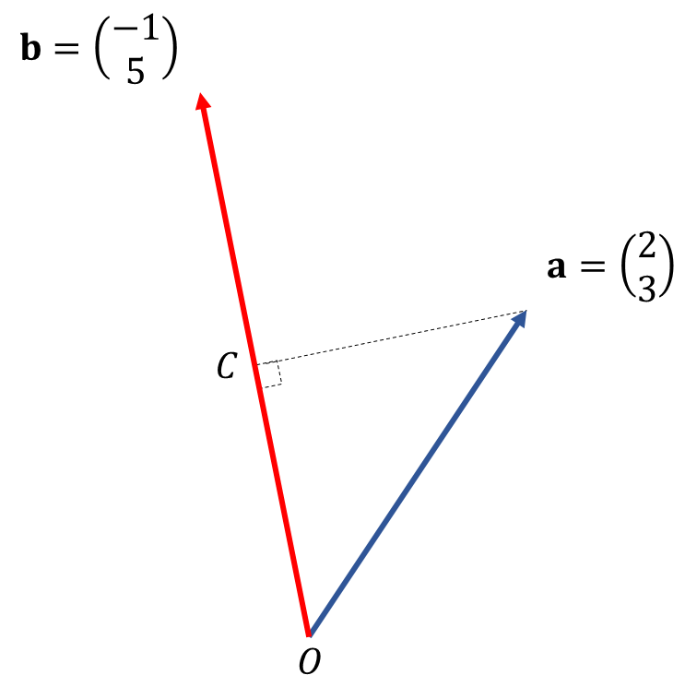
Scalar Projection (CL)
Find the scalar projection of onto .
[Example]
[Solution]

Slide 41
Test Yourself (CL)
Given the vectors and, compare
the scalar projection of onto to the scalar projection of onto .

Slide 42
One-minute write
Please stop what you are doing and produce a written response to either of the following in only one minute:
Identify what is the key learning concepts from the seminar, or
Write down a question with respect to the concepts learnt so far.
Link:

Slide 43
Learning Objectives
State that a vector has both magnitude and direction.
Convert vectors into various forms including as a column vector, in an algebraic equation and as a position or displacement vector in a geometric view.
Determine that vectors with the same magnitude and direction but different position are equal vectors.
Perform the basic vector operations for 2-dimensional and 3-dimensional vectors (i.e. Vector Addition, Vector Subtraction and Scalar multiplication.)
Perform scalar product operations for 2-dimensional and 3-dimensional vectors.
Apply scalar product operations to
obtain the scalar projection of a vector onto another,
obtain the angle between two vectors.

